Slide 1


To design and simulate a dielectric modulated and double AlGaN barrier plasma-based MOSHEMT for Bio-sensing applications.
AY 2021-25
GITAM UNIVERSITY
Capestone Project
A University should be a place of light, of liberty, and of learning.
Department of Electrical Electronics and Communication Engineering
Project Team:
KOUSHITHA C
NAGA CHAITANYA SV
MEGHANA M
Project Mentor:
Mr GIRISH SHANKAR MISHRA
www.gitamedu.com

Slide 2

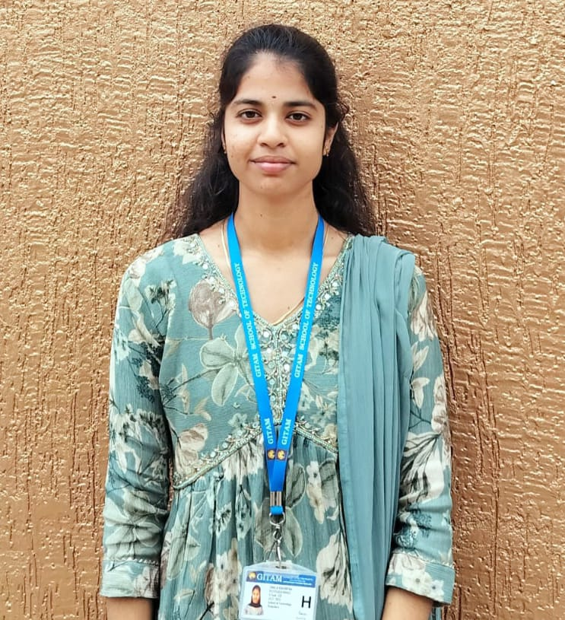

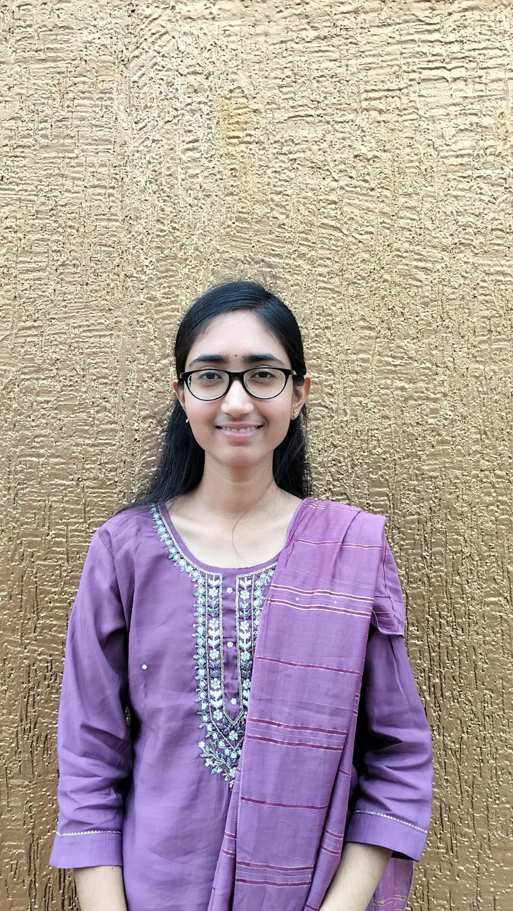
Project Group – Details
Photo
Track
Roll No
Name
EECE
BU21EECE0100403
KOUSHITHA C
EECE
BU21EECE0100521
NAGA CAHIATANYA SV
EECE
BU21EECE0100528
MEGHANA M

Slide 3
Objective and Goals
Objective
To design and simulate a dielectric modulated double AlGaN barrier plasma-based MOSHEMT for
Bio-sensing applications.
The main focus is on enhancing sensitivity and selectivity in detecting biomolecules using dielectric modulation and charge plasma techniques.
Goals
Main Goals
Enhancing sensitivity and selectivity
Implementing dielectric modulation
Implementing Double AlGaN barrier
Simulation and analysis
Additional Goals
Reducing fabrication complexity
Optimizing device performance
Exploring practical applications
Focus on structural optimization

Slide 4
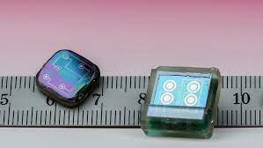
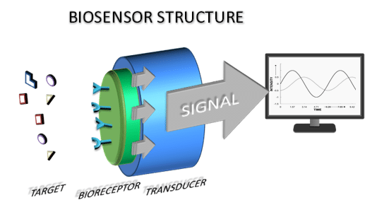
DEFINITION OF BIOSENSORS:
A biosensor is a device that detects and measures biological molecules by converting a biological response into an electrical signal.(definition)
DESCRIPTION OF BIOSENSOR:
A biosensor is an analytical device that combines a biological recognition element with a physicochemical detector to detect and quantify specific biological molecules, providing rapid and sensitive measurements in various applications such as medical diagnostics and environmental monitoring

Slide 5
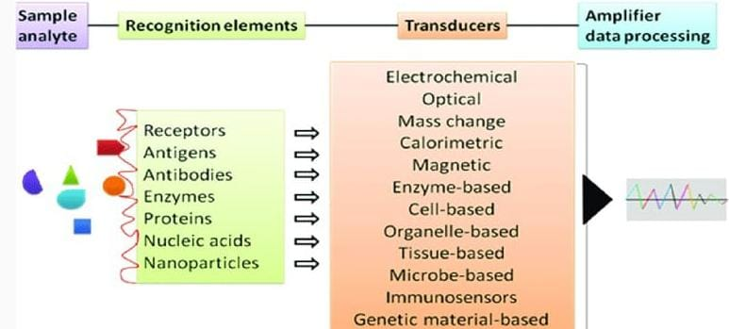
FUNCTIONS OF BIOSENSORS:
Detection
Quantification
Monitoring
Diagnosis
Environmental Monitoring
Food Safety
Bioprocess Control
Security

Slide 6
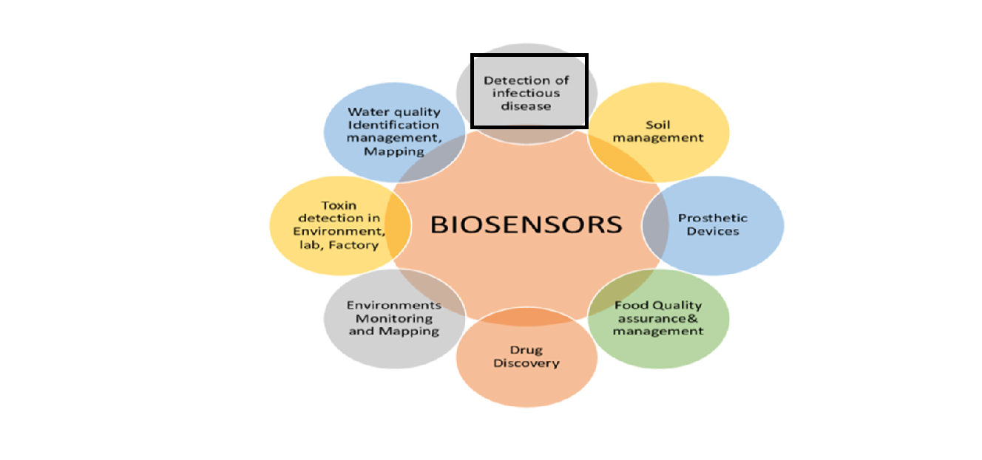
APPLICATION OF BIOSENSORS

Slide 7
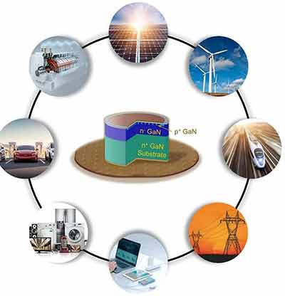
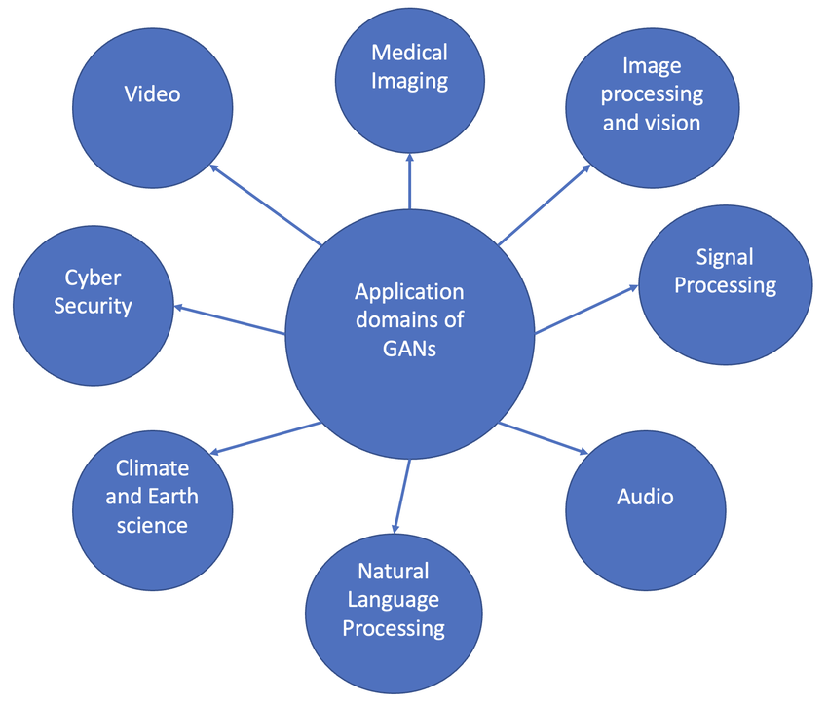
APPLICATIONS OF GaN:

Slide 8
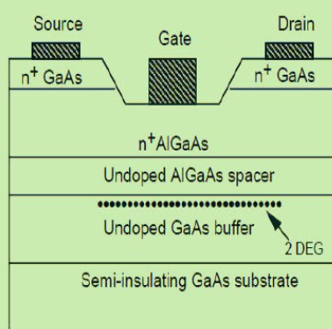
INTRODUCTION TO HEMT:
A High Electron Mobility Transistor (HEMT) is a special type of field-effect transistor known for its high speed and efficiency. It uses a combination of materials with different energy band gaps to create a very fast-moving layer of electrons, which makes it perfect for high-frequency applications like satellite communications, radar systems, and even in modern smartphones. HEMTs are like the speedy superheroes of the electronics world, working tirelessly to keep our advanced tech running smoothly!
ADVANTAGES
1. High-Frequency Operation
2. Low Noise
DISADVANTAGES:
1.High Fabrication Cost
2.Thermal Management

Slide 9
Key Features of HEMT
High Electron Mobility: HEMTs exhibit extremely high electron mobility due to the unique heterostructure design, enabling faster signal processing and high-frequency operation.
Low Noise: HEMTs have low noise figures, making them suitable for use in sensitive communication devices like satellite receivers and radar systems.
Wide Bandgap Materials: They often utilize wide bandgap materials like GaAs or GaN, which contribute to their superior performance in high-power and high-temperature environments.
Scalability: HEMTs can be scaled down in size, making them compatible with modern, miniaturized electronic devices.
High Thermal Conductivity: HEMTs, especially those made with materials like GaN, have high thermal conductivity, which helps in effective heat dissipation, enabling operation at higher power levels.
High-Frequency Performance: HEMTs are ideal for high-frequency applications, such as microwave and millimeter-wave circuits, due to their ability to operate efficiently at these frequencies
High Power Density: HEMTs can deliver high power density, making them ideal for compact, high-power applications like power amplifiers in wireless communication systems.

Slide 10
Project Plan (Gant Chart - Milestones and Activities)
MONTH | JULY(WEEK 1&2) | JULY(WEEK 3&4) | AUGUST(WEEK 1&2) | AUGUST(WEEK 3&4) | SEPTEMBER( WEEK 1,2,3) | OCTOBER(WEEK 1&2)
PHASE 1 (Abstract) | X
PHASE 2 (TCAD Simulation Setup) |  | X | X | X | X | X
PHASE 3 (Literature Review & Conceptual Design) |  |  | X | X
PHASE 4 (Device Simulation & Analysis) |  |  |  | X | X | X
PHASE 5 (Experimental Design & Prototype Fabrication) |  |  |  |  | X | X
PHASE 6 (Experimental Validation ) |  |  |  |  |  | X

Slide 11
Literature Survey
Sl | TITLE | METHODLOGY | MERITS | RESEARCH GAP | YEAR OF PUBLISHED
1 | Analytical Modeling and Simulation of AlGaN/GaN MOS-HEMT for High Sensitive pH Sensor | Device Simulation: Virtually fabricating an AlGaN/GaN MOS-HEMT structure with an electrolyte-filled cavity. Analytical Model Development: Modeling the drain current and threshold voltage changes for different pH levels. Validation: Comparing the model with experimental and simulated data to ensure accuracy and understand sensitivity. | High Sensitivity Quick Response Improved Device Performance Wide Range of Application | Limited Analytical Modeling Challenges in Exceeding the Nernstian Limit Complex Fabrication | IEEE Sensors Journal on June 15, 2021.

Slide 12
Literature Survey
Sl | TITLE | METHODLOGY | MERITS | RESEARCH GAP | PUBLISHED YEAR
2 | Linear and Circular AlGaN/AlN/GaN MOS-HEMT-based pH Sensor on Si Substrate: A Comparative Analysis | Device Calibration and Simulation: The AlGaN/GaN MOS-HEMT sensor is virtually fabricated, including a cavity for electrolyte solutions Analytical Model Development: An analytical model is created to predict drain current and threshold voltage changes based on different pH levels.Validation: The model is validated against experimental and simulated data to confirm its accuracy. | High Sensitivity Quick Response Improved Performance | Limited Analytical Modeling Challenges Beyond Nernstian Limit Complex Fabrication | August 18 2022

Slide 13
Literature Survey
Sl | TITLE | METHODLOGY | MERITS | RESEARCH GAP | PUBLISHED YEAR
3 | High-Sensitivity pH Sensor Based on Coplanar Gate AlGaN/GaN Metal-Oxide-Semiconductor High Electron Mobility Transistor | Device Fabrication: Growth of AlGaN/GaN heterostructures on sapphire substrates, followed by the deposition of GaN, AlGaN, and SiO₂/Ta₂O₅ layers. Resistive Coupling: Using resistive coupling between the control gate (CG) and sensing gate (SG) to enhance sensitivity. Extended Gate Sensing: Utilizing an extended gate sensing unit to prevent direct exposure of the HEMT to pH solutions. | High Sensitivity Beyond the Nernst Limit Cost-effective and Damage-Resistant Design Potential for Integration with Advanced Electronics | Limited Exploration of Hysteresis and Drift Scalability for Commercial Applications Broader Application Testing | Published: 25 February 2021

Slide 14
Literature Survey
Sl | TITLE | METHODLOGY | MERITS | RESEARCH GAP | YEAR OF PUBLISHED
4 | A Dielectric-Modulated Normally-Off AlGaN/GaN MOSHEMT for Bio-Sensing Application: Analytical Modeling Study and Sensitivity Analysis | Device Fabrication: The AlGaN/GaN MOSHEMT device was fabricated using metal-organic chemical-vapor deposition (MOCVD) on a silicon substrate. Simulation: A 2D drift-diffusion model simulated carrier transport, considering biomolecule dielectric constants, energy bands, and surface potential. Analytical Modeling: The study developed an analytical model for the dielectric-modulated AlGaN/GaN MOSHEMT, focusing on the threshold voltage shift (ΔVth) induced by the presence of biomolecules. The model was validated against TCAD simulation result | High Sensitivity Label-Free Detection Compatibility with CMOS Technology Operation in Harsh Environments | Lack of Analytical Studies on MOSHEMT Need for Experimental Validation Optimization of Device Parameters | Received 6 August 2019, in final form 17 September 2019

Slide 15
Literature Survey
Sl | TITLE | METHODLOGY | MERITS | RESEARCH GAP | YEAR OF PUBLISHED
5 | Fabrication and Charge Deduction Based Sensitivity Analysis of GaN MOS-HEMT Device for Glucose, MIG, C-erbB-2, KIM-1, and PSA Detection | Device Fabrication: AlGaN/AlN/GaN MOS-HEMT device was fabricated using Metal Organic Chemical Vapor Deposition (MOCVD) on a silicon substrate, followed by deposition of source/drain and gate contacts. Charge Deduction Model: Developed a charge deduction-based approach to estimate device sensitivity for various biomarkers by applying equivalent interface charge as gate bias. Sensitivity Analysis: Sensitivity of the device was evaluated using various sensing metrics like drain current, channel potential, and channel conductance for different biomarkers. | Device Fabrication Charge Deduction Model Sensitivity Analysis | Real-Time Validation Charge Distribution Assumption Optimization of Sensing Metric | 2019 edition of IEEE Transactions

Slide 16
Literature Survey
Sl | TITLE | METHODLOGY | MERITS | RESEARCH GAP | YEAR OF PUBLISHED
6 | A Dielectric-Modulated Normally-Off AlGaN/GaN MOSHEMT for Bio-Sensing Application: Analytical Modeling Study and Sensitivity Analysis | Device Fabrication and Simulation: The AlGaN/GaN MOSHEMT was fabricated on silicon using MOCVD, with a nanogap cavity added for biosensing. Its performance was analyzed via 2D drift-diffusion TCAD simulations, focusing on changes in threshold voltage (ΔVth) and drain current (Id) due to biomolecules. Analytical Modeling: Developed an analytical model to predict the device's sensitivity to biomolecules by calculating changes in the threshold voltage and drain current based on dielectric modulation and the presence of biomolecules in the cavity region. | High Sensitivity Versatility Cost-Efficiency | Real-Time Validation Charge Distribution Assumptions Optimization of Sensing Metrics | 6 August 2019, in final form 17 September 2019

Slide 17

L_{G} = 2μm
L_{SG} = 2μm
L_{DS} = 6μm
L_{cavity} =1 μm
L_{oxide}=1 μm
Gate
L_{S} = 5μm
L_{D} = 5μm
Oxide(Al2O3)
Source
GaN cap(1nm)
Drain
AlGaN barrier(10nm)
AlGaN barrier(5nm)
GaN channel(300nm)
AlN(5nm) 16nm
Substrate(10 μm)

Slide 18
Substrate:
The substrate in a HEMT structure provides a stable mechanical base and supports the layers above it, enabling the overall device to function effectively.
AlN layer:
In a HEMT structure, AlN (Aluminum Nitride) serves as a buffer layer that improves the crystal quality and strain management between different materials, enhancing electron mobility and overall device performance.
GaN Layer:
In a HEMT, the GaN (Gallium Nitride) channel is the active layer where high electron mobility occurs, allowing for efficient charge transport and high-speed operation, which is crucial for the device’s high-frequency and high-power performance.
Double AlGaN barrier:
The double AlGaN barriers in a HEMT create a stronger potential well for better electron confinement, enhancing electron mobility, reducing leakage currents, and improving overall device performance for high-speed and high-frequency applications.
GaN cap:
The GaN cap in a HEMT protects the underlying layers, provides a high-quality surface for further processing, and can enhance the device's performance by improving thermal stability and reducing surface defects.

Slide 19
Source:
In a HEMT, the source terminal provides the entry point for charge carriers (electrons) into the transistor. It is where the current flows from the channel to the external circuit, playing a crucial role in establishing the electrical connection for current conduction and facilitating the overall operation of the device.
Drain:
The drain terminal functions as the point where charge carriers (electrons) exit the transistor after they have traversed the channel from the source. It is essential for completing the electrical circuit, allowing the transistor to control and amplify current flow based on the voltage applied at the gate.
Oxide(Al2O3)
In a HEMT, the Al₂O₃ (alumina) oxide layer acts as a dielectric insulator, providing electrical isolation between the gate and the underlying semiconductor layers, which enhances gate control and reduces leakage currents.
Gate:
In a HEMT, the gate layer controls the flow of charge carriers between the source and drain by modulating the electric field, thereby regulating the transistor's switching and amplification capabilities.
BioMolecules:
Biomolecules in HEMTs can function as sensitive detectors or functionalization agents, enabling the device to perform specific biochemical sensing or analysis tasks by interacting with biological substances.

Slide 20
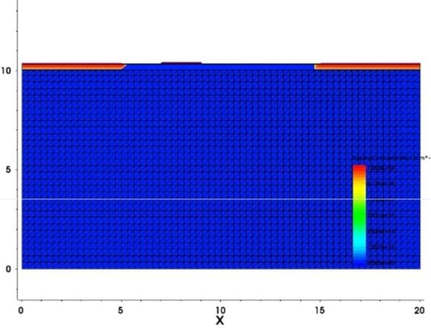
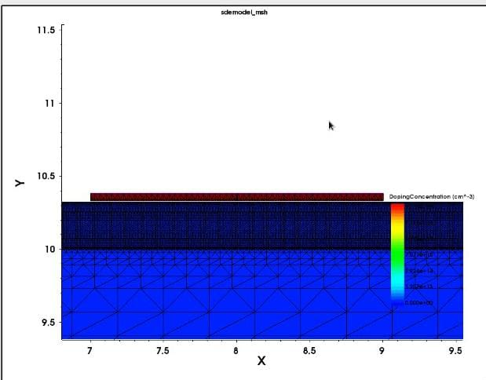
Structure visualization from TCAD software

Slide 21
BIOMOLECULES | PERMITIVITY/DIELECTRIC
zein | 5
APTES | 3.57
Cholesterol Oxidase (ChOx) | 3.3
Biotin | 2.63
protein | 2.5
strepdavidin | 2.1
uricase | 1.54
Air | 1

Slide 22

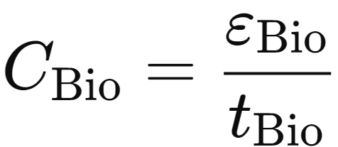
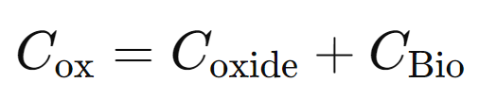

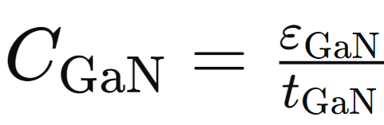
hhhhhm
C_{ox}: Capacitance between the gate and the channel.
𝜀_{ox}: Permitivity of the gate oxide material.
_{tox}: Thickness of the oxide layer.
C_{bio}: Capacitance.
𝜀_{bio}:Permittivity of the biological material.
t_{bio}:Thickness of the biological layer.

Slide 23




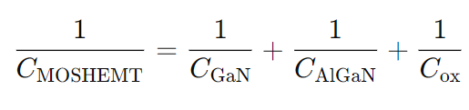



:: Permittivity of the AlGaN material.
m: This variable could represent a physical parameter.
ε0=is the permittivity of free space, approximately
Saturation region:
Linear region:

Slide 24
Analysis - SWOT
Strengths
Weaknesses
W1. Simulation-only
W2. Potential fabrication
W3. Device Complexity
S1. High sensitivity and selectivity
S2. Fabrication simplicity
S3. Enhancement of surface area
Threats
T1. Manufacturing challenges
T2. Lack of technological advancaments
Opportunities
O1. Biosensing application
02. Healthcare Integration
O3. Future research
04. Market Demand

Slide 25
Analysis – 4W1H
Why: A highly sensitivity, low-power, and scalable biosensor for detecting biomolecules that can be integrated into portable and wearable diagnostic devices. Such sensors are crucial for advancing healthcare monitoring early disease detection and personalized medicine
What: We mainly focus on the design and simulation of dielectric-modulated double-barrier charge plasma-based metal oxide semiconductor high electron mobility transistor(MOSHEMT) for biosensing applications, to enhance selectivity and sensitivity of the device by using dielectric modulation and double AlGaN barrier.
Where: This is mainly applicable in the field of biomedical diagnostics with potential deployment in portable and variable for real-time health monitoring systems, these devices can be used in both clinical and non-clinical settings for detecting biomolecules like protein, nucleic acid, and small molecules.
When: The present phase involves the simulation of the device structure with future work planned for experimental validation and optimization of the device and mainly focuses on progressing from simulation to real-world testing and deployment
How: The device leverages the use of dielectric modulation to detect biomolecules by creating cavities in the gate dielectric, leading to changes in the electrical properties
Refined Objective: The objective is to design and simulate a dielectric modulated double AlGaN barrier charge plasma-based MOSHEMT for high sensitivity selectivity and scalable biosensing application suitable for portable and variable diagnostic devices

Slide 26
Use Cases & Testing
Use Cases
Medical Diagnostics
Environmental Monitoring
Food Safety
Personalized Medicine
Test Cases
Initial Device Validation
Sensitivity and Selectivity Testing
Prototype Fabrication and Initial Testing
Experimental Sensitivity and Selectivity Testing
Environmental and Operational Testing
Final Optimization and Application Testing

Slide 27
Conclusion & Future Work
Summary:
The dielectric-modulated dual-channel charge plasma-based MOSHEMT is designed for biosensing, enhancing sensitivity and selectivity by integrating dielectric modulation and dual-channel architecture. TCAD simulations perform better in detecting biomolecules than conventional biosensors, with potential applications in portable diagnostic devices. The device features high sensitivity, low power consumption, and simplified fabrication through charge plasma techniques.
Conclusion:
The dielectric modulated dual-channel MOSHEMT biosensor significantly advances biosensing by offering higher sensitivity and selectivity than traditional biosensors. It combines dielectric modulation and charge plasma techniques for label-free biomolecule detection, with a larger sensing area and better channel control. Simulation results show promise in detecting biomolecules like proteins and nucleic acids, making it suitable for portable and wearable biomedical devices. Future research will focus on experimental validation and device optimization for specific biosensing applications.
Future Work:
Future we are will focusing on the experimental validation of the simulation results to confirm the effectiveness of the dielectric modulated dual-channel MOSHEMT biosensor. Additionally, efforts will be directed towards optimizing the device structure for specific biosensing applications, including the detection of various biomolecules. This will involve refining the fabrication process, improving device sensitivity and selectivity, and exploring integration possibilities into portable and wearable diagnostic devices. Moreover, the study will investigate the scalability and commercial viability of the device, potentially leading to its use in real-world biomedical applications.

Slide 28
Contribution
Team Progress and Movement
Working on the designing of strcture
Individual Contribution
Key contributions: Koushitha
Literature survey
Strcture design
PPT design
Key contributions:Naga Chaitanya
Literature survey
Strcture design
PPT design
Key contributions:
Literature survey
Strcture design
PPT design

Slide 29

THANK YOU

